Slide 1
Software Engineering
Homework Alarm System
10조

Slide 2

Contents
System purpose
System Architecture
Based Program
Scenario

Slide 3

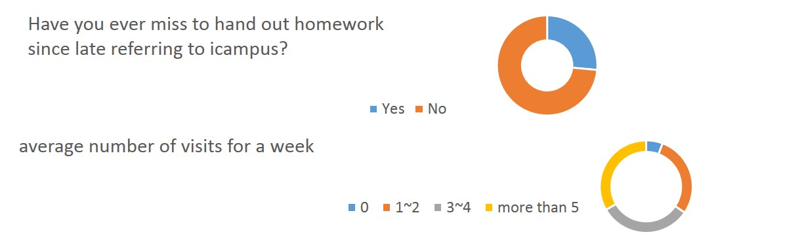
System Purpose

Slide 4
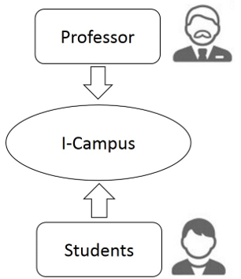



System Purpose
I-Campus

Slide 5
System Architecture
-Architecture Overview
HAS
Professor Login approval
Information Administrator
Set alarm
Send alarm
Edit/Insert/Delete Student information
Edit/Insert/Delete Class information

Slide 6

System Architecture
-Application Overview
Set H/W alarm
Send H/W alarm
Smartphone
Prof. login approval
Home
Information Administrator
Web
Database

Slide 7
System Architecture
-Prof. Log-in approval subsystem
Set H/W alarm
Send H/W alarm
Smartphone
Prof. login approval
Home
Information Administrator
Web
Database

Slide 8
System Architecture
-Information Administrator subsystem
Set H/W alarm
Send H/W alarm
Smartphone
Prof. login approval
Home
Information Administrator
Web
Database

Slide 9
System Architecture
-Set H/W alarm subsystem
Set H/W alarm
Send H/W alarm
Smartphone
Prof. login approval
Home
Information Administrator
Web
Database

Slide 10
System Architecture
-Send H/W alarm subsystem
Set H/W alarm
Send H/W alarm
Smartphone
Prof. login approval
Home
Information Administrator
Web
Database

Slide 11
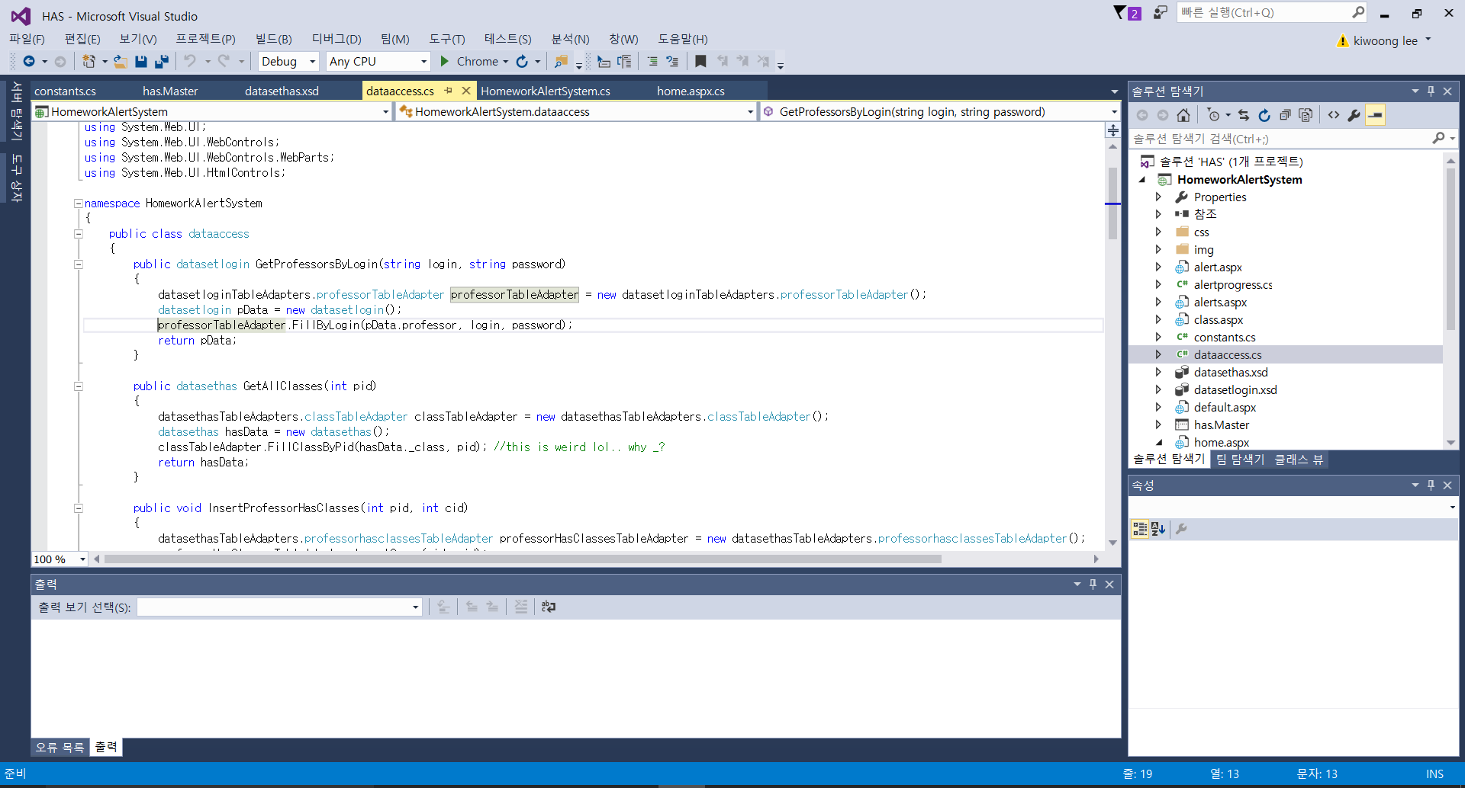
Based Program
-C#

Slide 12
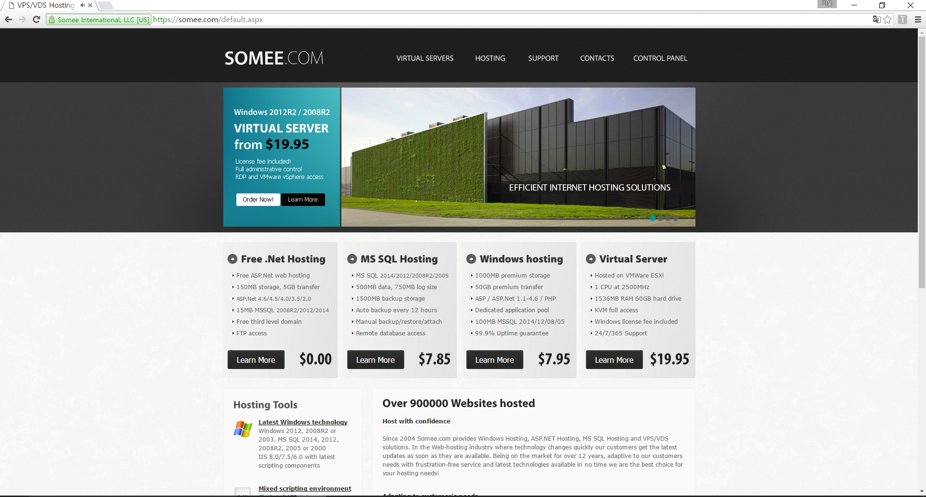
Based Program
-Homepage builder

Slide 13
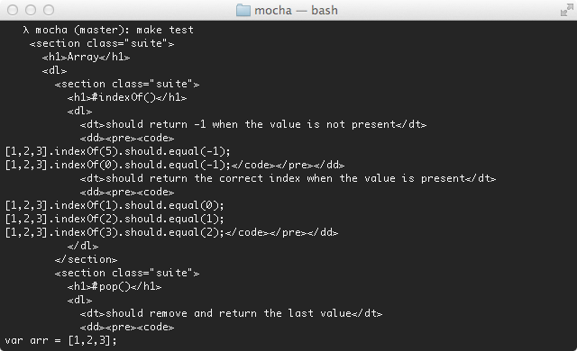
Based Program
-Java script

Slide 14
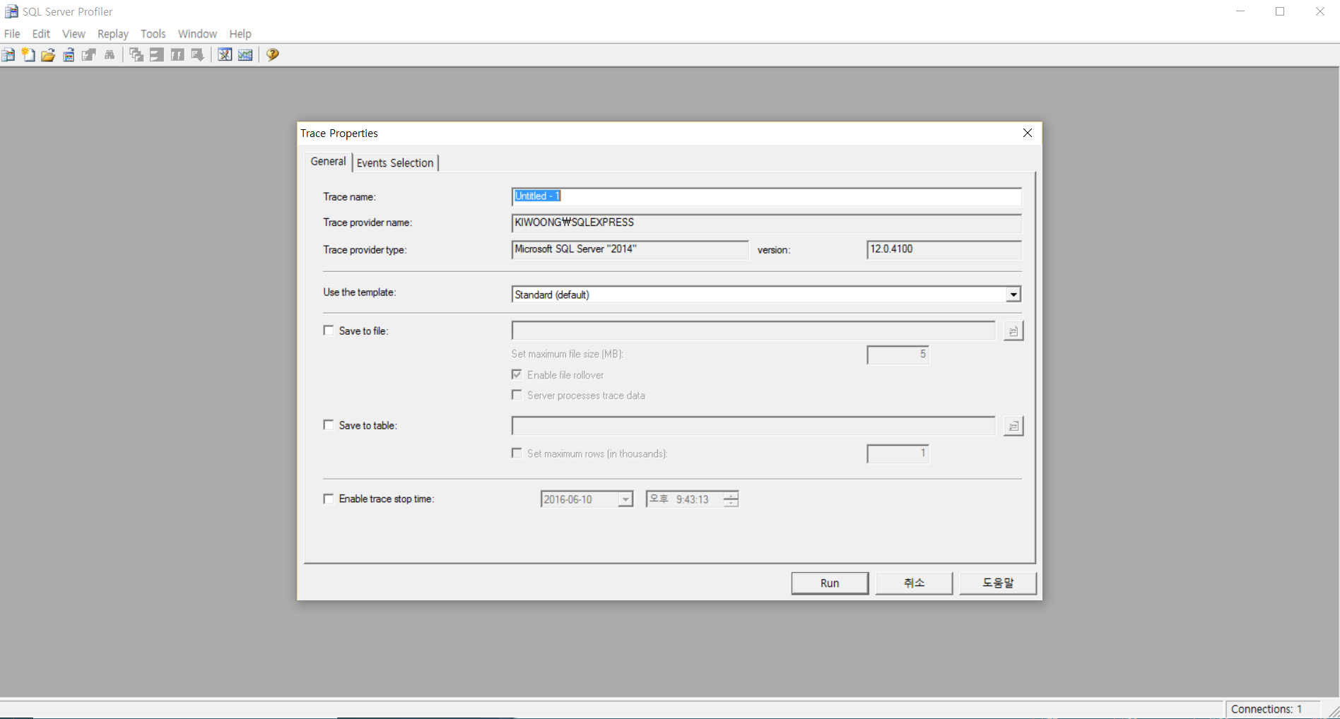
Based Program
-SQL Server Profiler

Slide 15
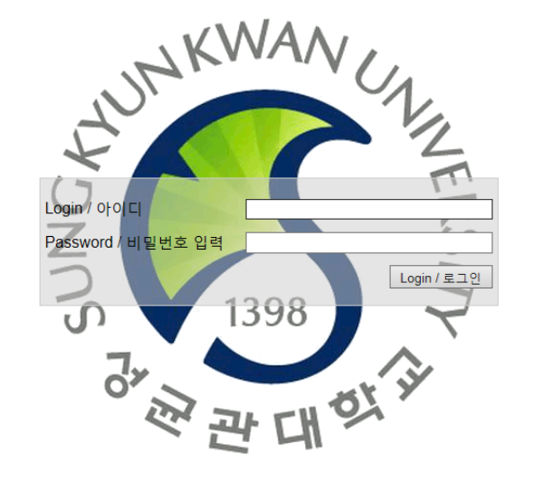
Scenario
-Login

Slide 16
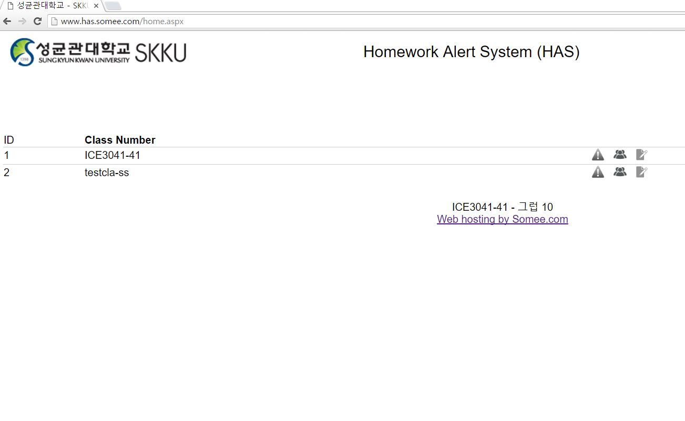
Scenario
-Home
Edit Class

Slide 17
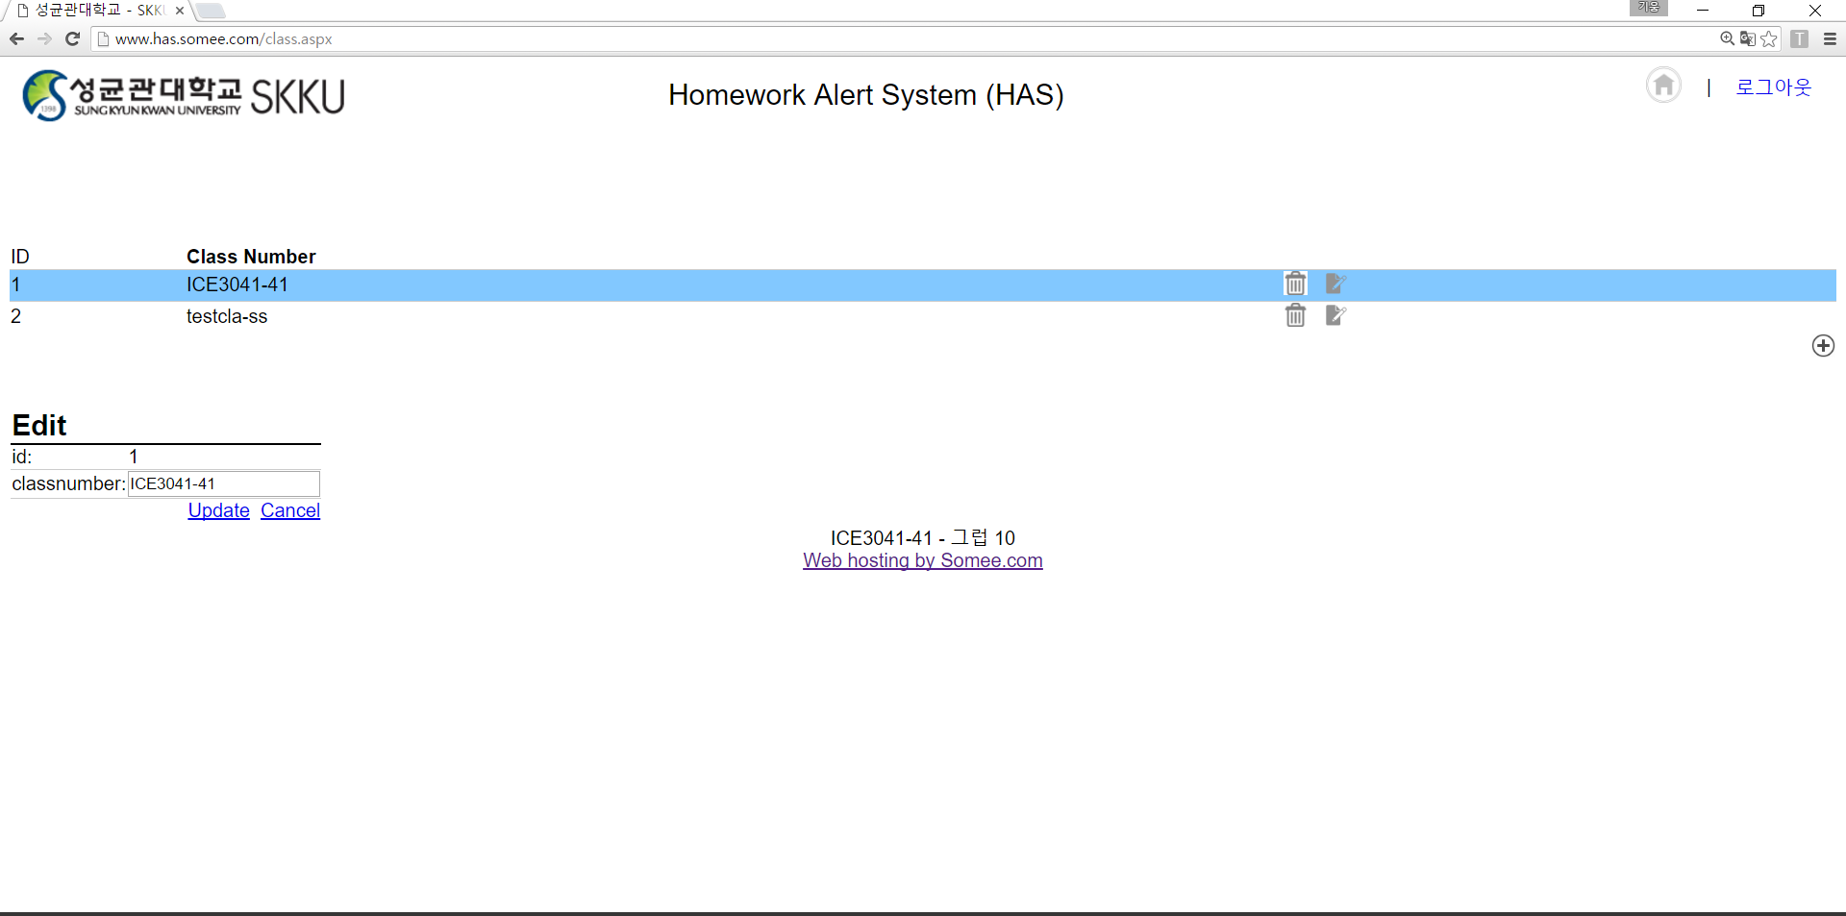
Scenario
-Edit Class

Slide 18
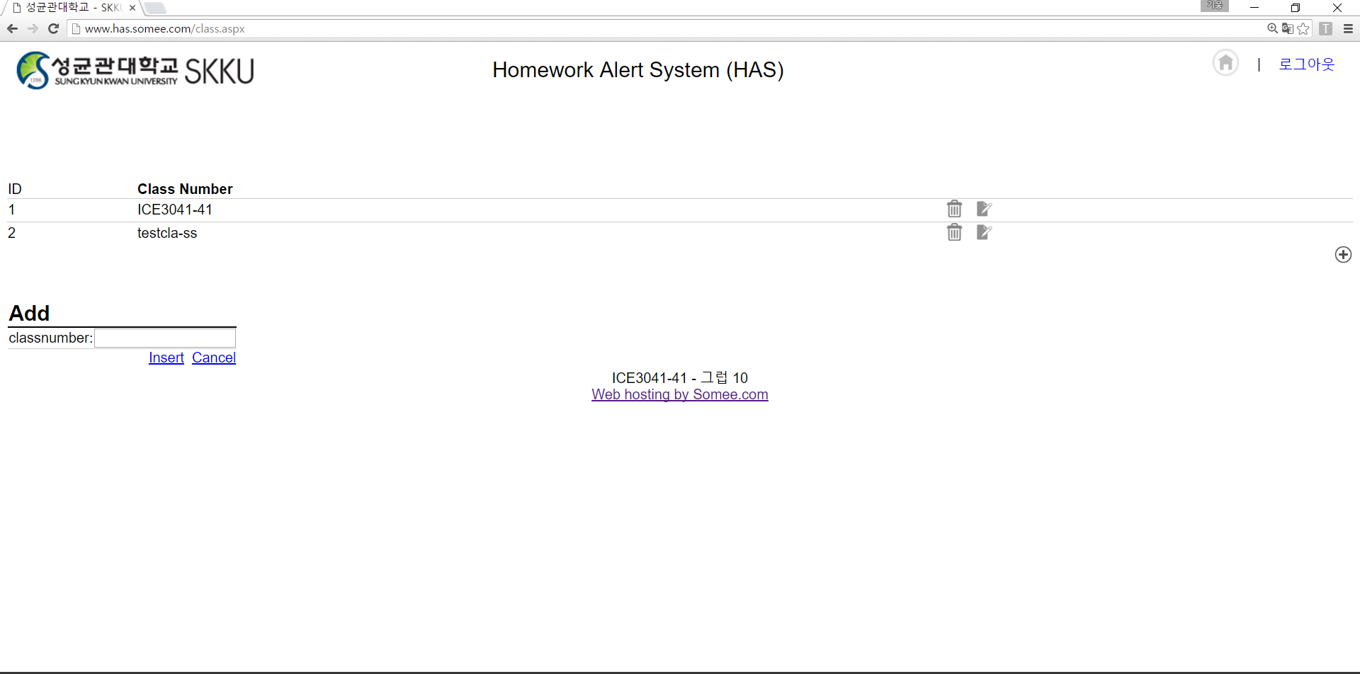
Scenario
-Edit Class
You can go ‘Home’

Slide 19
Scenario
-Home
Edit Student

Slide 20
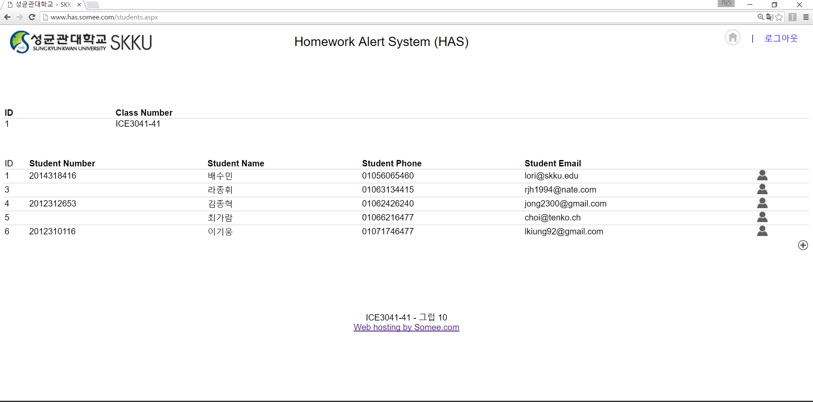
Scenario
-Edit Student
Edit each student
Add New student

Slide 21
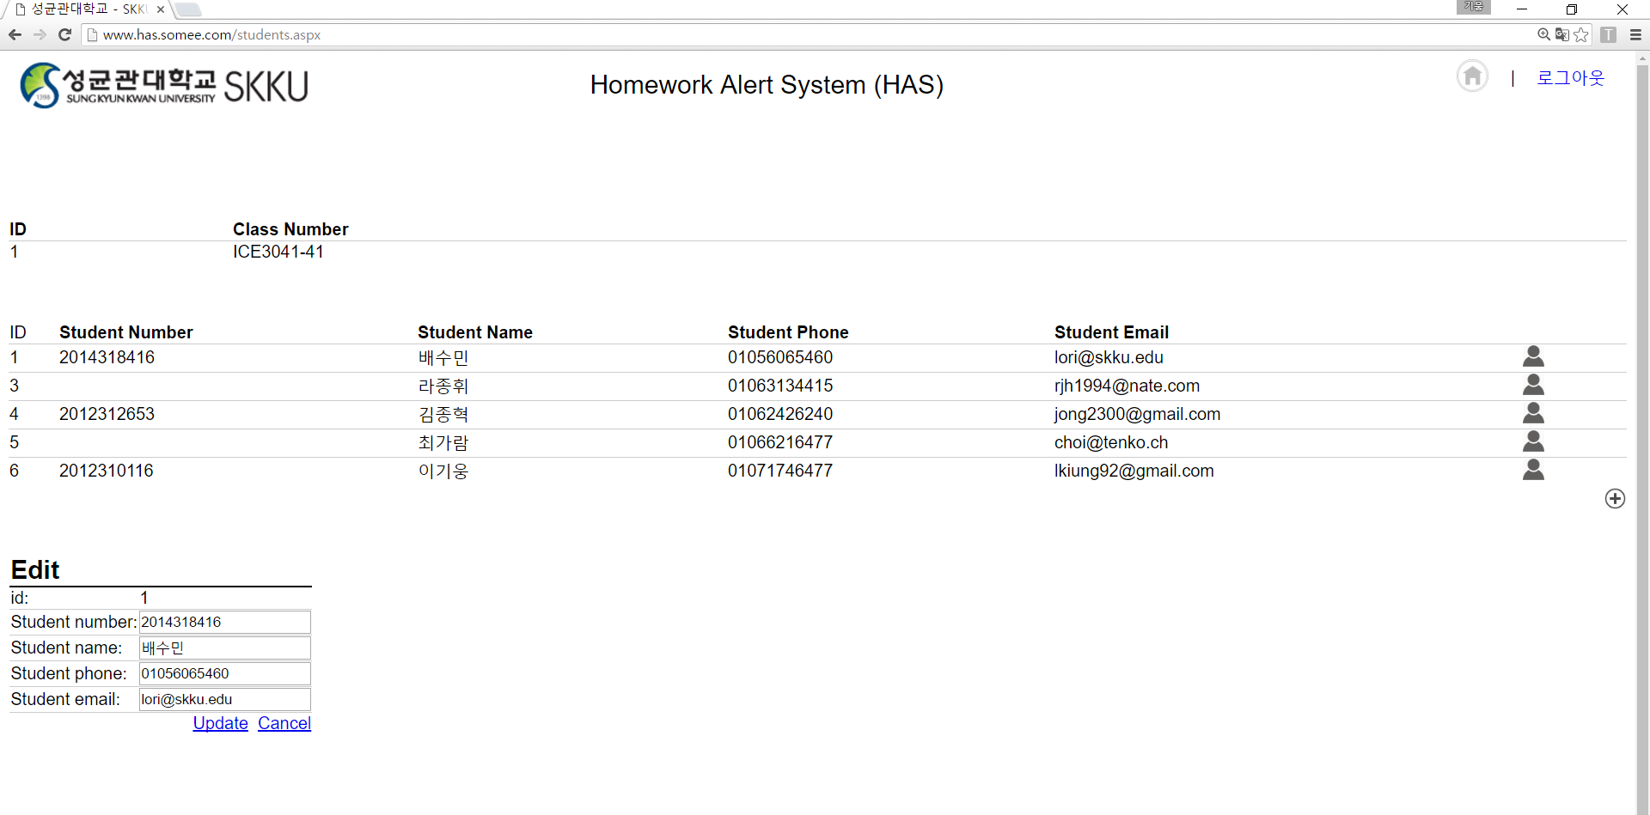
Scenario
-Edit Student
You can update students information

Slide 22
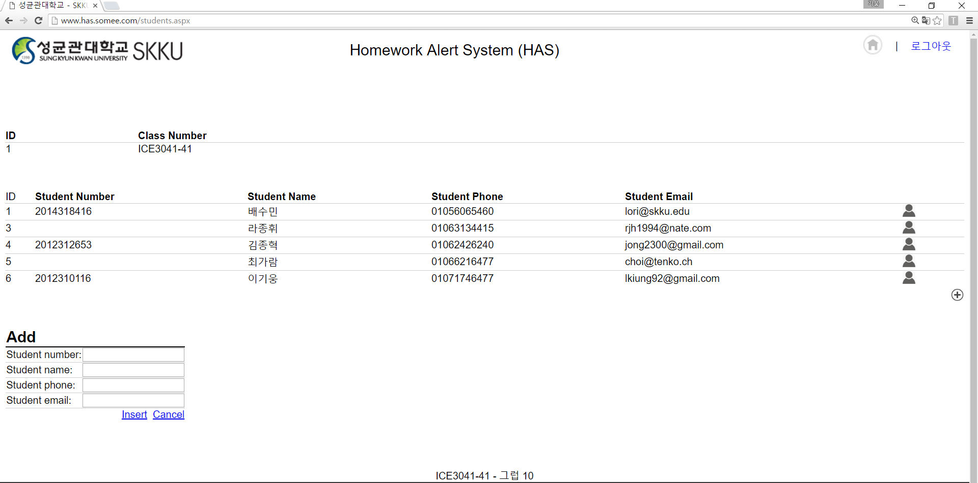
Scenario
-Edit Student

Slide 23
Scenario
-Home
Send Alert Message

Slide 24
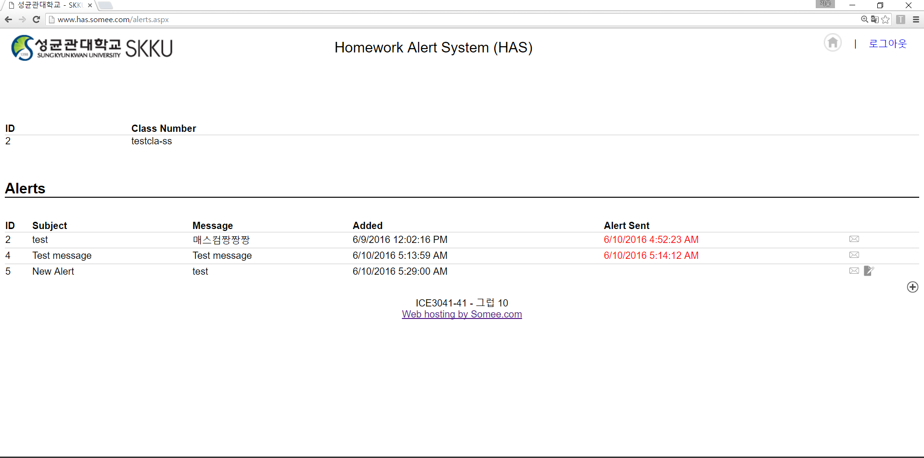
Scenario
-Send Alert Message
You can add new alert

Slide 25
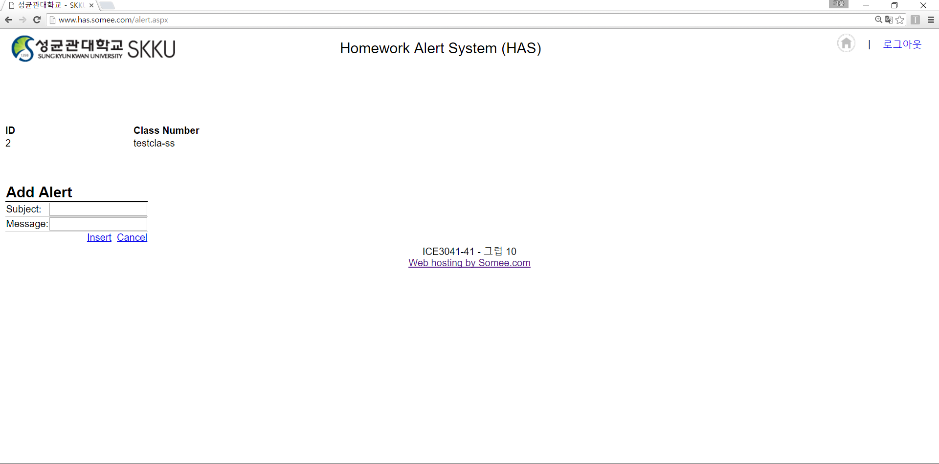
Scenario
-Send Alert Message
Insert homework Information

Slide 26
Scenario
-Send Alert Message
You can see new alert is added
Send Alert
Edit before send

Slide 27
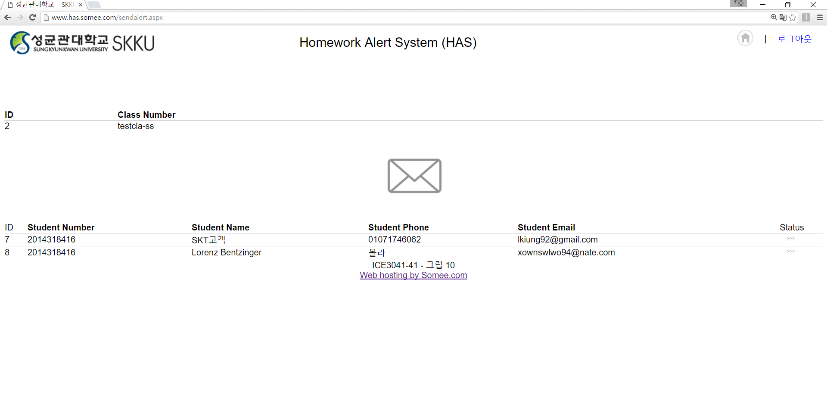
Scenario
-Send Alert Message
Click and Send
Information of receiver

Slide 28
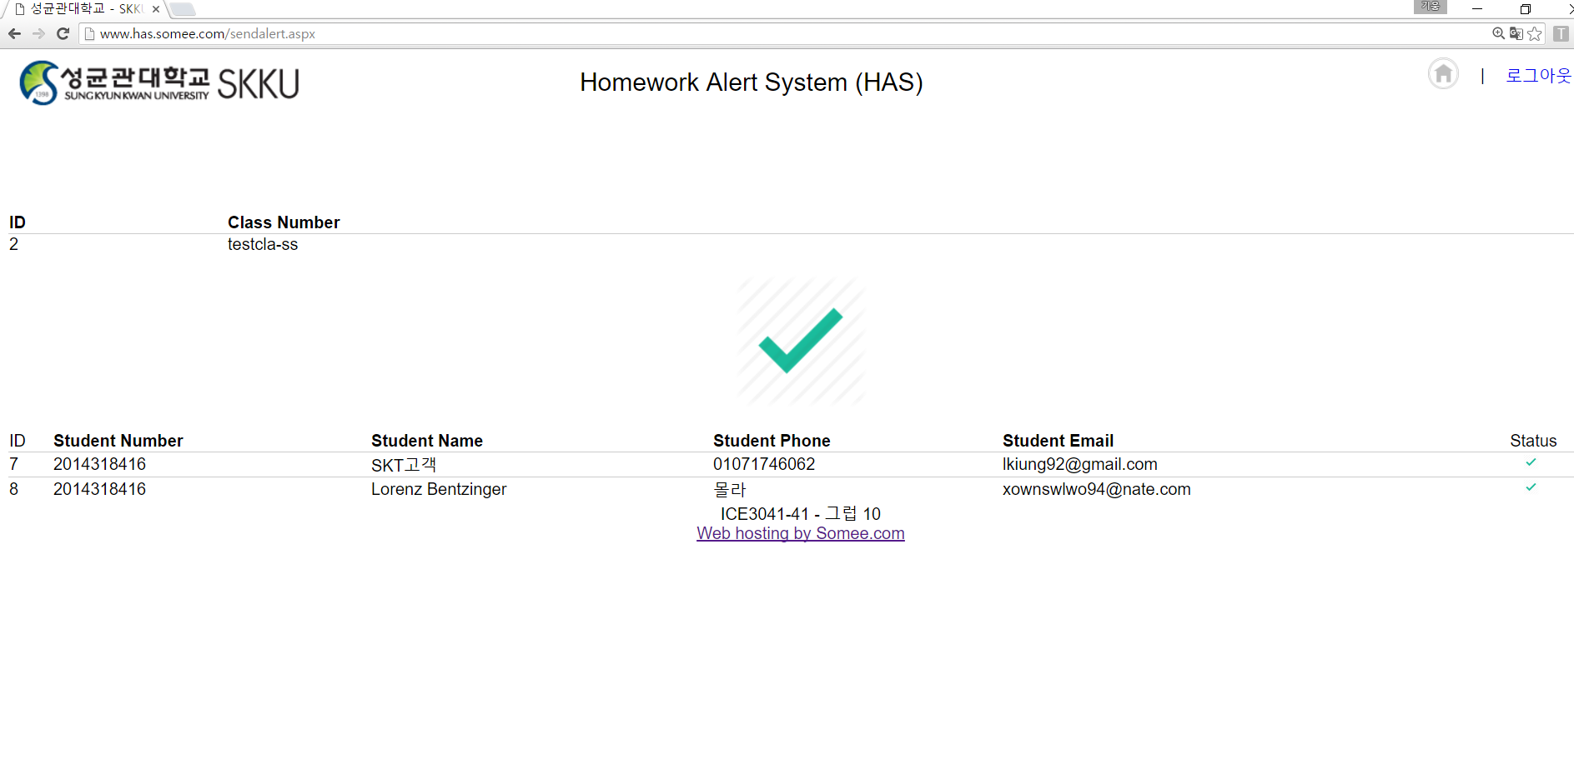
Scenario
-After send message

Slide 29
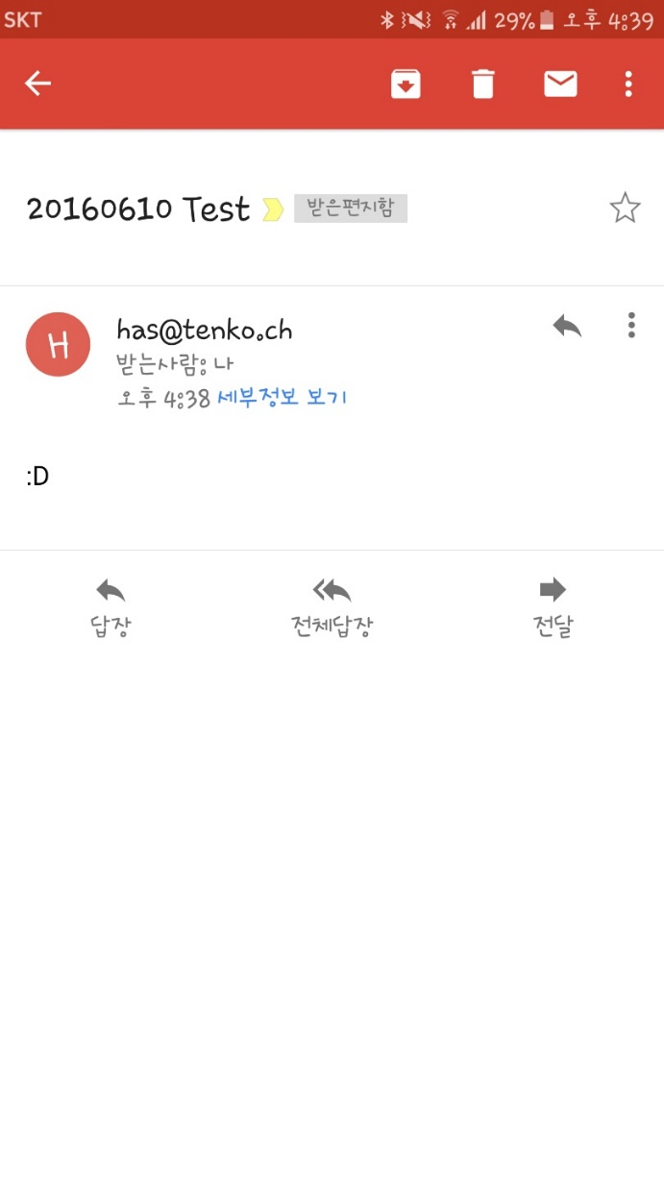
Scenario
-After send message

Slide 30
Thank You

